Slide 1

Uber Analytics Dashboard
Comprehensive business intelligence solution for tracking performance, revenue, and operational metrics across all ride-sharing activities.

Slide 2


OVERVIEW
Key Performance Indicators
12.5K
1.2K
$485K
89K
Completed Bookings
Lost Bookings
Revenue
Total Distance
Total successful rides delivered
Cancelled or failed rides
Total earnings generated
Miles traveled across all rides

Slide 3

Temporal Analysis
Monthly Trends
Quarterly Performance
Track booking completion rates and revenue performance month-over-month to identify seasonal patterns and growth opportunities.
Analyze quarterly booking volumes and revenue streams to understand long-term business health and strategic planning needs.
Booking completion tracking
QTR booking metrics
Revenue aggregation
Revenue trend analysis
Comparative analysis
Vehicle type filtering

Slide 4



Location Intelligence
Top Pickup Locations
Popular Drop-off Points
Busy Time Slots
Identify high-demand pickup zones based on booking frequency and optimize driver positioning.
Track most frequent destinations to understand travel patterns and service demand.
Analyze peak hours and busy areas to maximize driver availability during high-demand periods.

Slide 5

VEHICLES
Vehicle Performance Metrics
Booking Count
Revenue Generation
Total rides completed per vehicle type with detailed breakdown and contribution analysis.
Track earnings by vehicle category to identify most profitable segments.
Contribution Analysis
Measure each vehicle's impact on overall business performance and market share.
Comprehensive vehicle filtering enables deep-dive analysis into performance by car type, helping optimize fleet composition and pricing strategies.

Slide 6




Revenue Breakdown
By Customer
By Vehicle
Segment revenue by customer type and behavior patterns
Analyze earnings across different vehicle categories
Temporal Analysis
By Payment Method
Monthly and quarterly revenue tracking for trend identification
Track preferred payment options and transaction trends

Slide 7

QUALITY
Ratings & Satisfaction
Monitor service quality through dual-perspective ratings system. Track both rider satisfaction and driver performance to maintain high service standards and identify improvement opportunities.
4.7/5
Avg Rider Rating
Customer satisfaction score
4.8/5
Avg Driver Rating
Driver performance score

Slide 8

Rider Insights & Behavior
01
02
Cancellation Analysis
Payment Preferences
Track cancelled rides by reason to identify service gaps and reduce booking losses.
Analyze payment method distribution across monthly and quarterly periods.
03
Rider Segmentation
Categorize users as first-time, returning, or regular riders with detailed data tables.

Slide 9

LOCATION
Distance & Geographic Analysis
Monthly Distance Tracking
Distance by Vehicle Type
Monitor total miles traveled each month to understand service utilization and operational scale across the network.
Break down total distance by vehicle category to optimize fleet deployment and maintenance scheduling.
Busy Areas Identification
Pinpoint high-activity zones and time slots to improve driver positioning and reduce wait times.

Slide 10
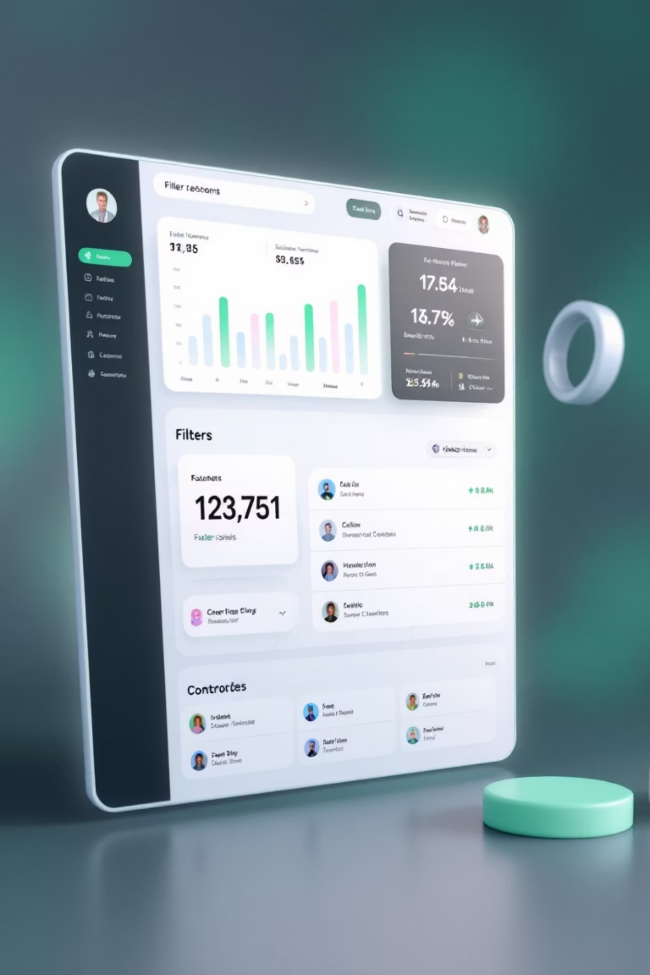

Advanced Filtering & Customization
Flexible Filter Panel
Enhanced User Experience
Hide and show filter panel for optimal screen space management. Apply multiple filters across all reports:
Dynamic filtering enables personalized analysis and faster insights across all dashboard pages.
Vehicle type selection
Date range customization
Location-based filtering
Payment method options
Rider segment selection

